Slide 1
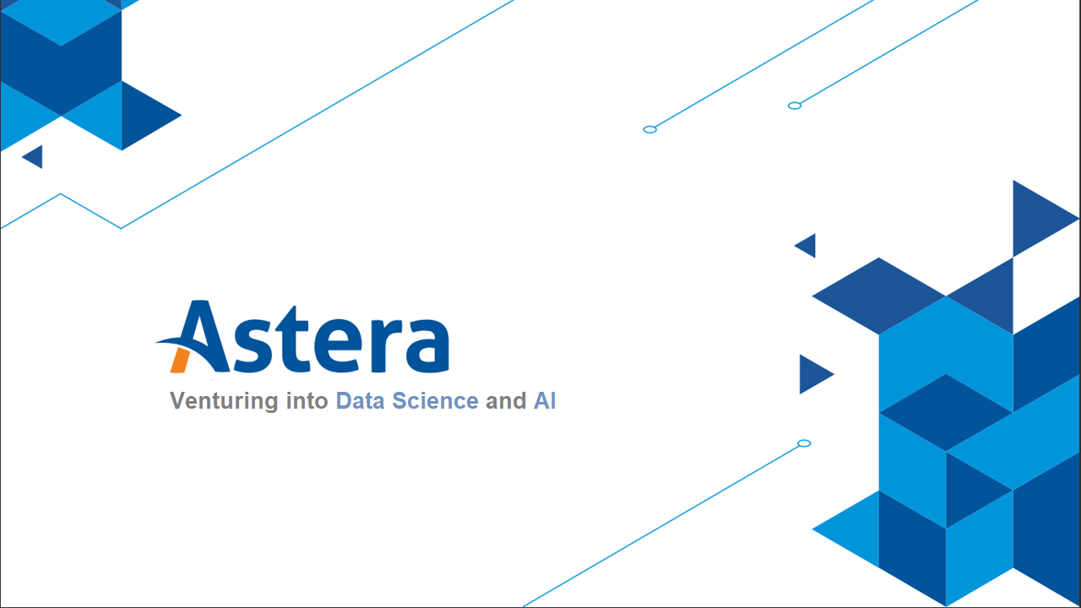
Notes:
In 2018, in China, there were two rounds of competition held of a team of elite neuro surgeons against a neuroimaging AI system called BioMind. This AI system beat human doctors in neuroimaging recognition contest with a 2:0 score.
Walmart, the world’s largest retailer, supposedly found out that there are certain times at which beer and diapers sell particularly well together – when on Friday evenings young men make a last dash to the supermarket to get beer and their wives call after them, “Pick up some diapers, too, honey!”
“Some of the ways Wal-Mart managers found to exploit their findings are legendary. One such legend is the story, “diapers and beer”. Wal-Mart discovered through data mining that the sales of diapers and beer were correlated on Friday nights. It determined that the correlation was based on working men who had been asked to pick up diapers on their way home from work. On Fridays the men figured they deserved a six-pack of beer for their trouble; hence the connection between beer and diapers. By moving these two items closer together, Wal-Mart reportedly saw the sales of both items increase geometrically.”

Slide 2

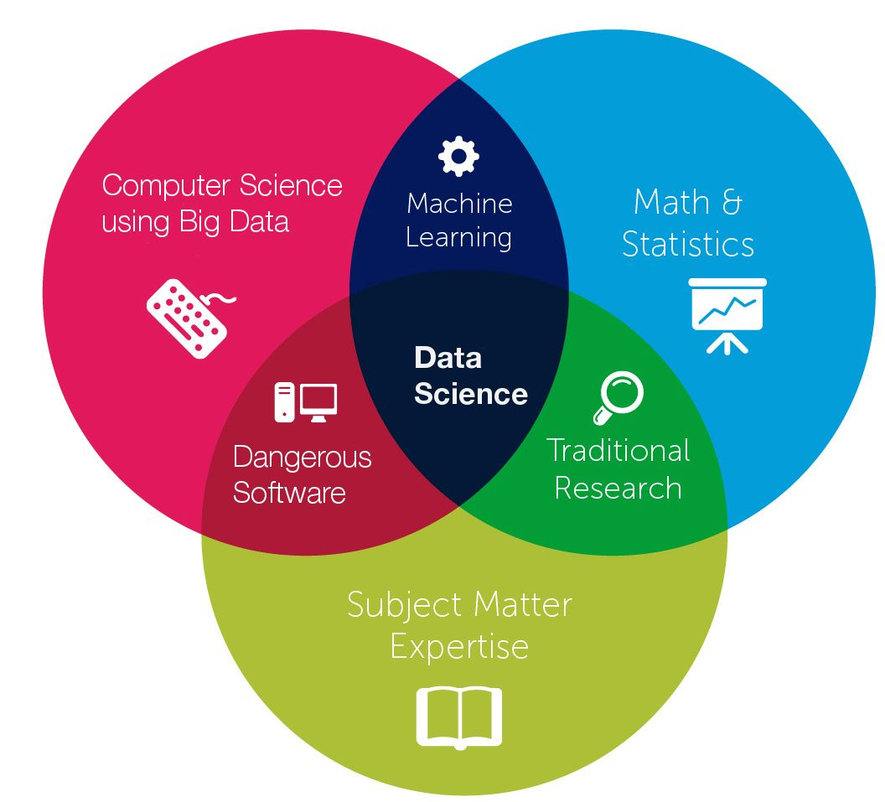
What is Data Science?
Data Science is simply at the intersection of Mathematics, Computer Science, and Domain Expertise.
Notes:
Ask the audience what data science is?
Importance of subject matter expertise in data science.

Slide 3
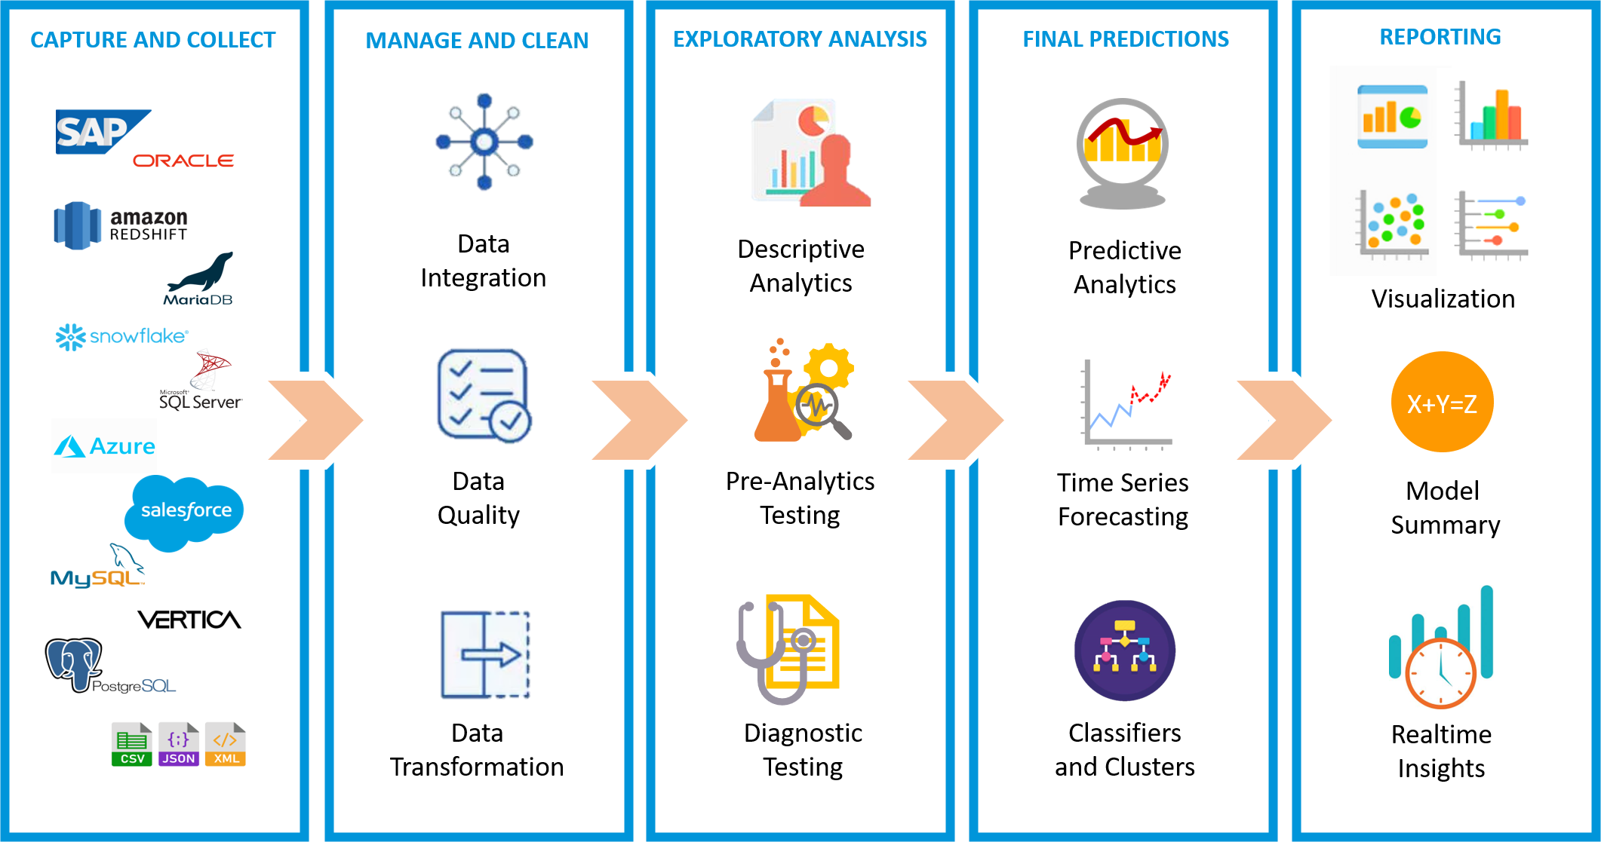
Data Science Workflow

Slide 4

What is Analytics?
Analytics is the discovery, interpretation and communication of meaningful patterns found in the data. It helps individuals and companies:
In assessing their performance and current state
Analyzing consequences of an action
In decision making
Acquire efficiency
In creating a competitive edge

Slide 5
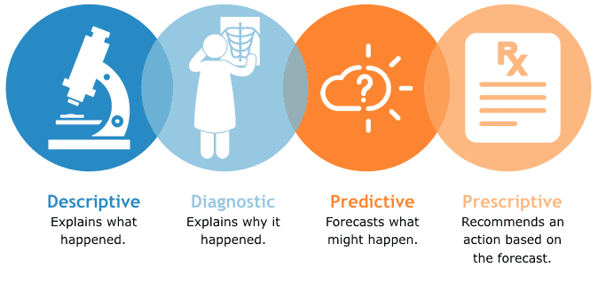
Types of Analytics

Slide 6
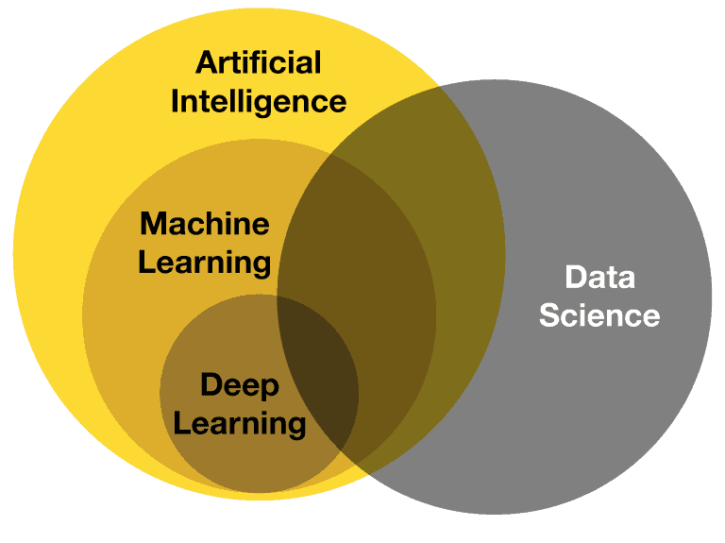
Data Science vs Artificial Intelligence vs Machine Learning
Data Science: Extract meaning from structured and unstructured data.
Machine Learning: Provide a way for systems to learn from data.
Artificial Intelligence: Enable computers to perform complex intellectual tasks like humans.
Notes:
Data Science is not just running machine learning or deep learning models but follows any systematic approach used to make sense of data.
For example, Data Visualization which is not AI or Machine Learning but a combination of both Data Science and Arts/Creativity in which a data scientist should know the principles of creating meaningful visuals using the data that tells the story hiding behind those facts.
Data Science: Extract meaning from structured and unstructured data to inform decision-making and planning. We are building and learning
Machine Learning: Provide a way for systems to synthesize data, learn from it and use the insights to improve over time. Now find a way for machine to learn.
Artificial Intelligence: Enable computers to perform complex intellectual tasks like humans, including decision-making, and problem-solving.
Building >> Learning >> Practicing

Slide 7
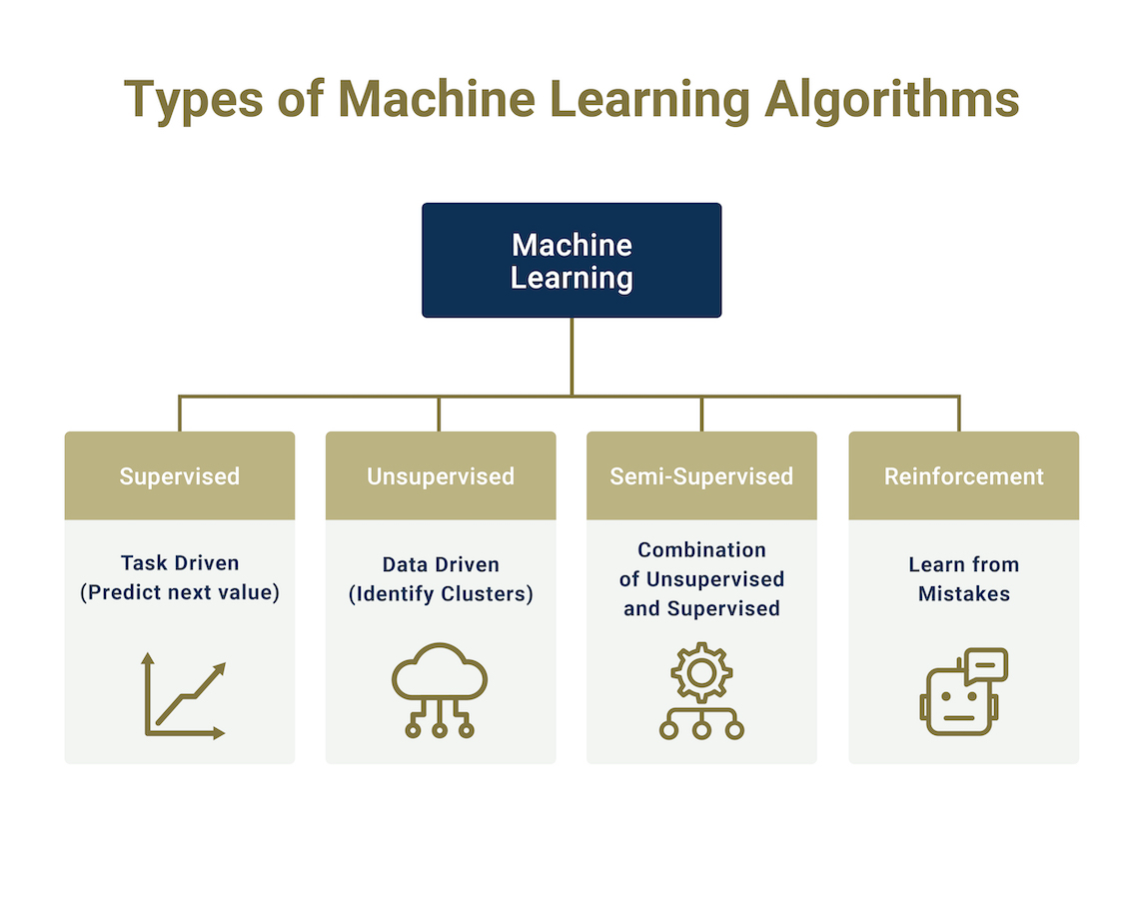
Types of Machine Learning
Notes:
Supervised Learning – Train Me!
Supervised Learning is the one, where you can consider the learning is guided by a teacher. We have a dataset that acts as a teacher and its role is to train the model or the machine. Once the model gets trained it can start making a prediction or decision when new data is given to it.
Unsupervised ML – I am self-sufficient in learning
The model learns through observation and finds structures in the data. Once the model is given a dataset, it automatically finds patterns and relationships in the dataset by creating clusters in it.
Semi-Supervised Learning
Similar data is clustered along with an unsupervised learning algorithm, and further, it helps to label the unlabeled data into labeled data.
Reinforcement Learning – My life My rules! (Hit & Trial)
It is the ability of an agent to interact with the environment and find out what is the best outcome. It follows the concept of hit and trial method. The agent is rewarded or penalized with a point for a correct or a wrong answer and based on the positive reward points gained the model trains itself.

Slide 8
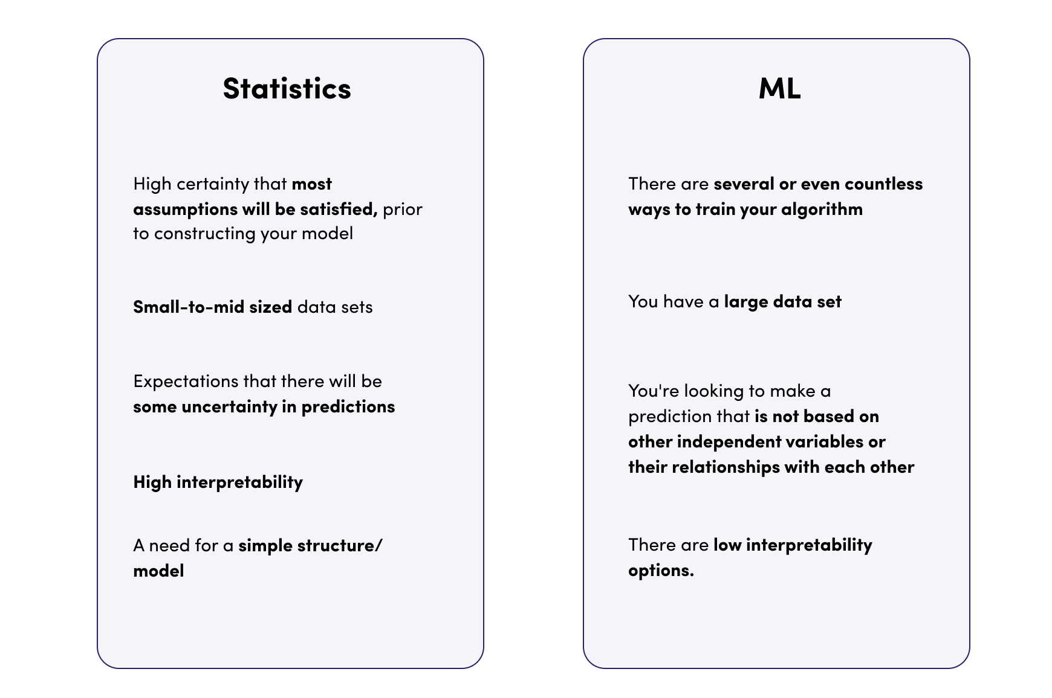
Statistical Analysis vs Machine Learning
Parametric Approach
Parametric & Non-Parametric Approach
Notes:
There is no such thing as training in statistical algorithsm, there is model fitting.
Learning is where we split the data in train and test.

Slide 9
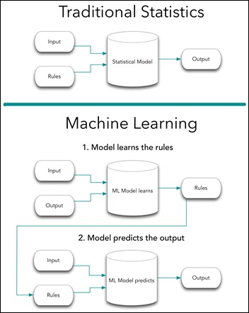
Statistical Analysis vs Machine Learning

Slide 10
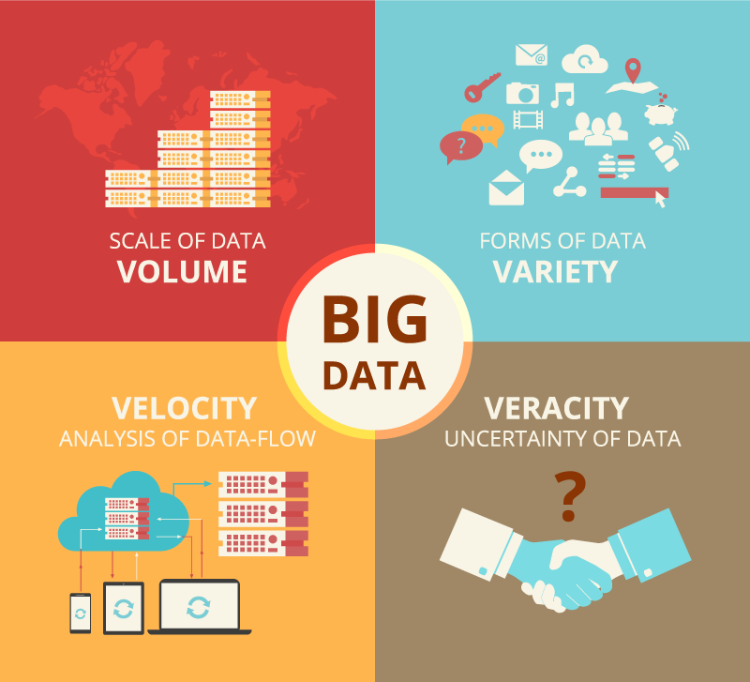
What is Big Data Analytics?
A complex process of examining big data to uncover information that can help organizations make informed business decisions.
Notes:
A complex process of examining big data to uncover information such as hidden patterns, correlations, market trends, and customer preferences that can help organizations make informed business decisions.
4V’s of Big Data:
Volume: The huge amount of data continuously generated.
Velocity: The speed at which the data is generated. (Real-time)
Variety: The types of data: Structured, Unstructured and Semi-Structured
Veracity: The degree to which big data can be trusted. Consistent data

Slide 11
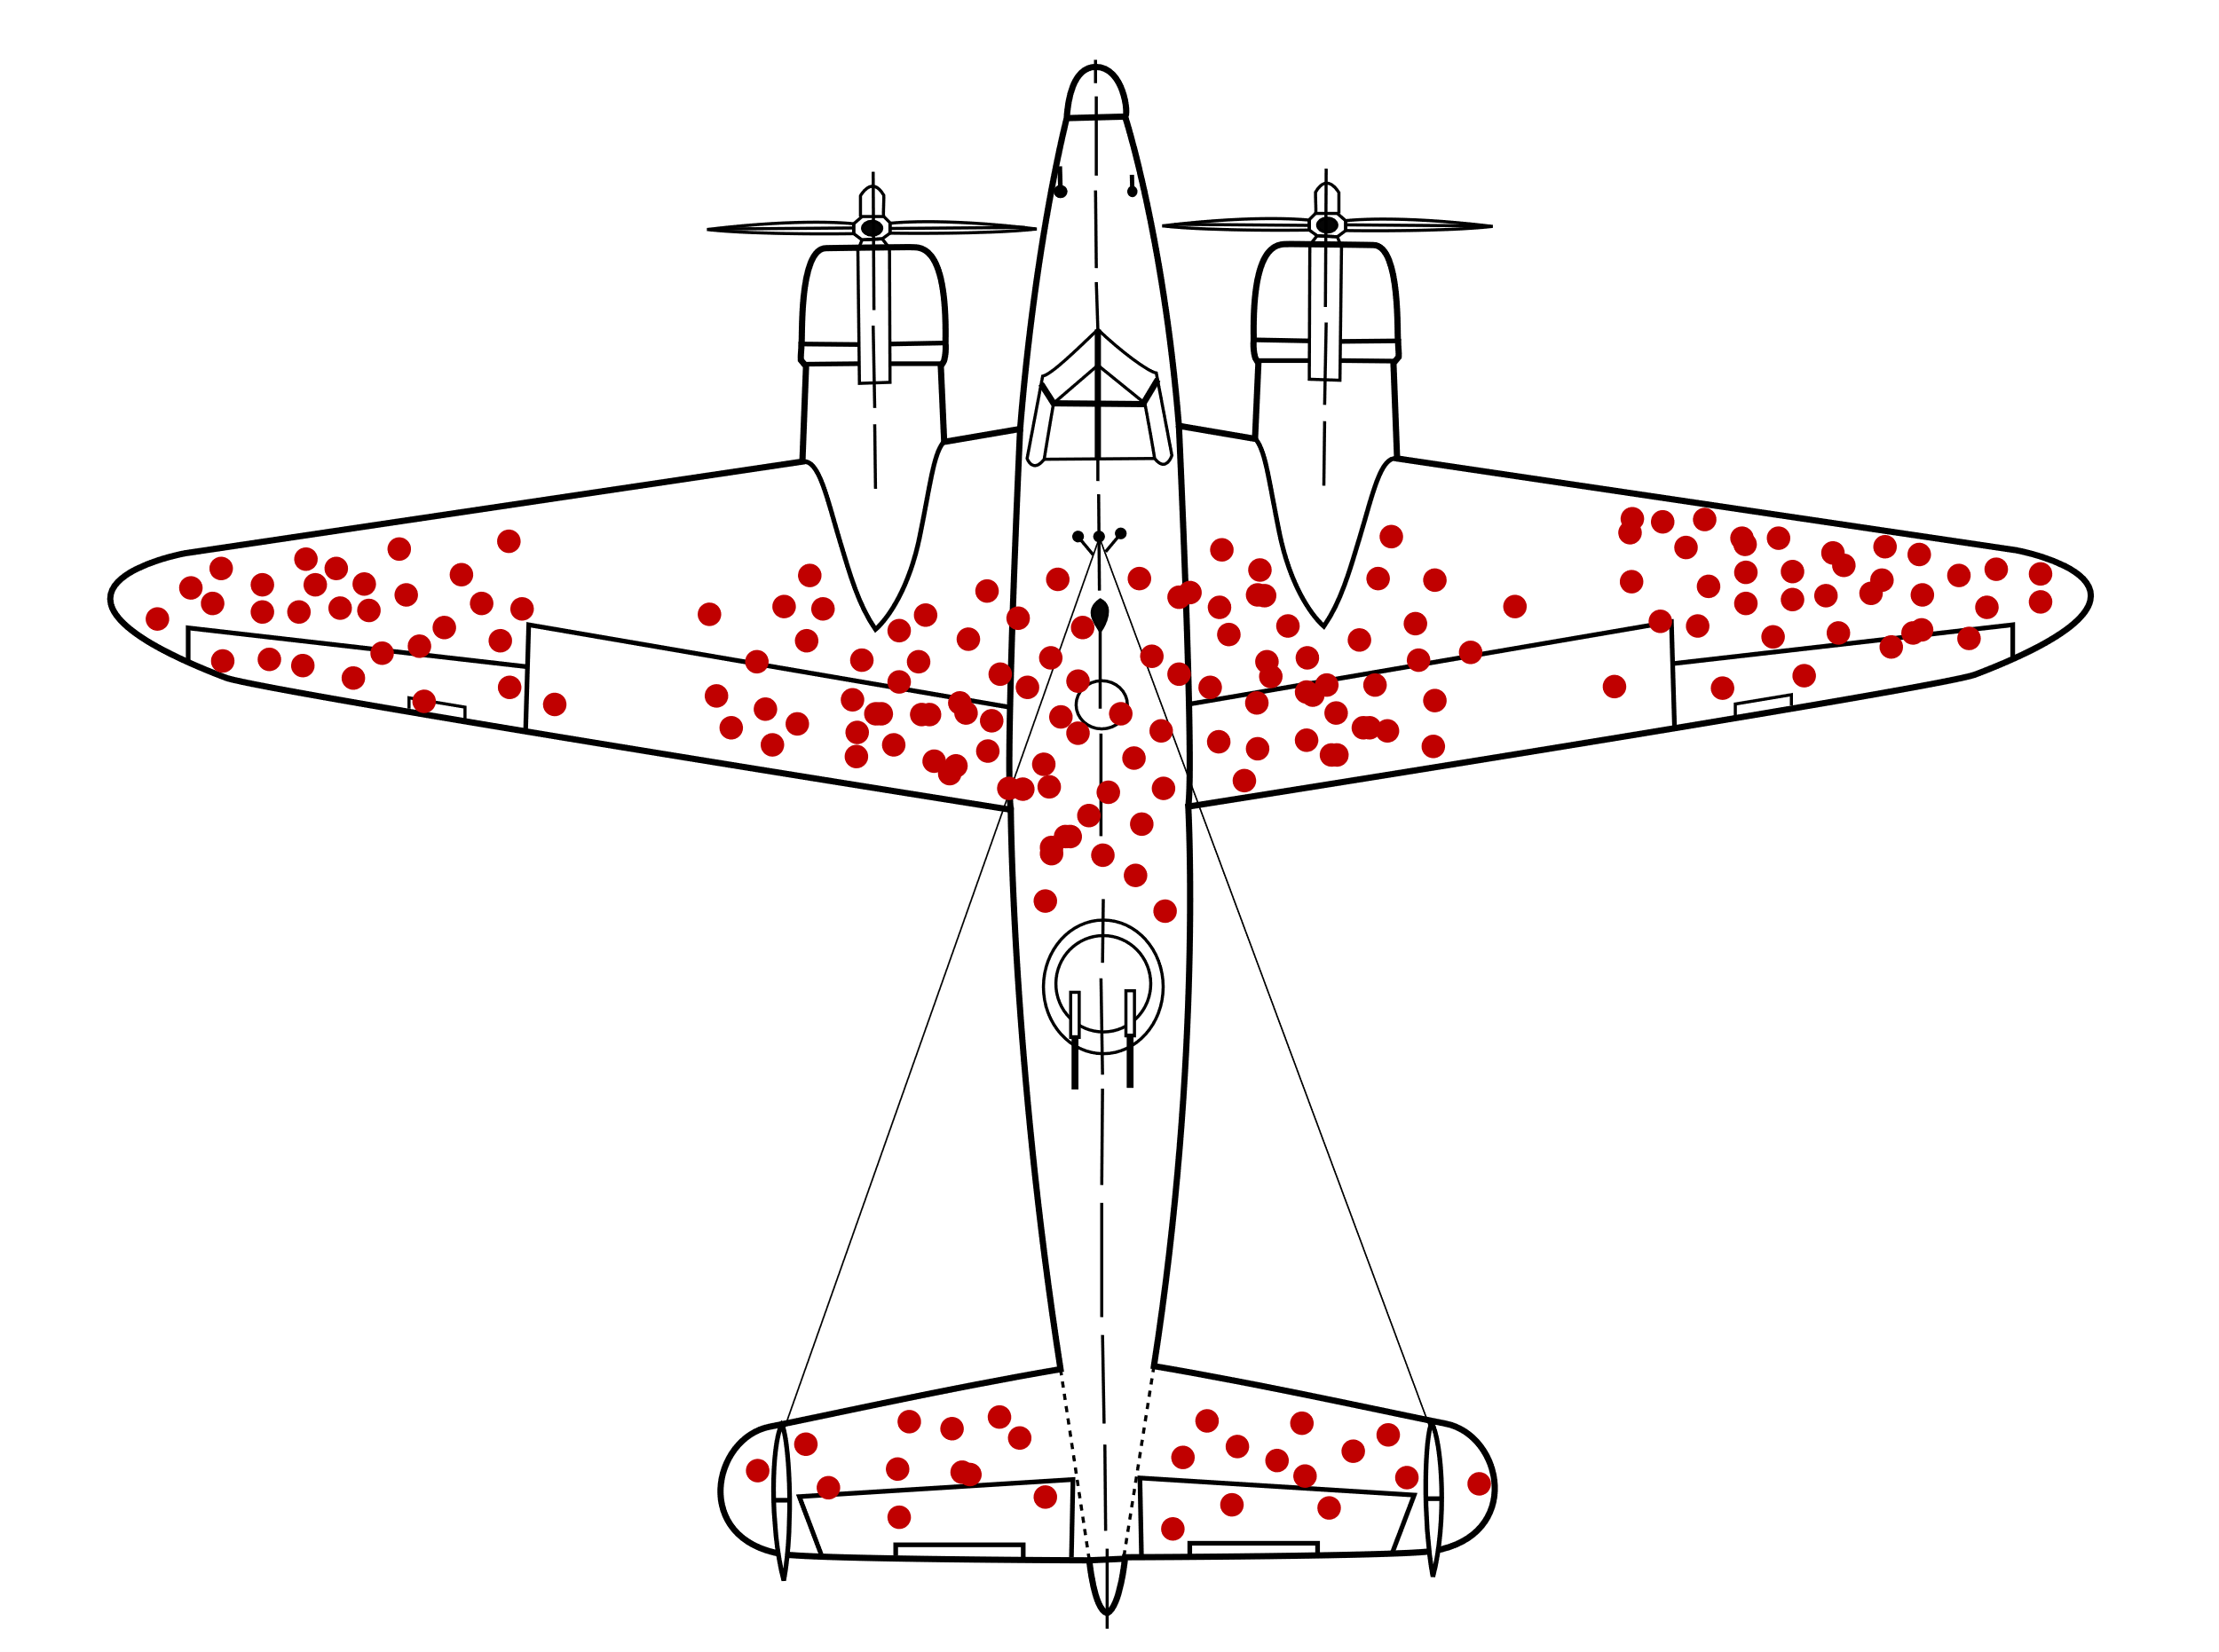
Brain Teaser 01
Consider how to minimize bomber losses to enemy fire by examining the damage done to aircraft that had returned from missions.
Notes:
The bullet holes in the returning aircraft represented areas where a bomber could take damage and still fly well enough to return safely to base. Therefore, Wald proposed that the Navy reinforce areas where the returning aircraft were unscathed, inferring that planes hit in those areas were the ones most likely to be lost.

Slide 12

Brain Teaser 01
Survivorship Bias!
Notes:
Survivorship bias is a common form of a logical error where the data that we are presented is representative of only a subset of the population that has already survived a filtering process, meaning that our data lacks important information underestimating the true population that the data comes from.
Image 01: Our data is only from returning flights.
Image 02: An initial guess at how to fix this might be to apply additional armor platting to the parts of the plane with the most holes.
Image 03: However, this is where planes that returned had bullet holes. The planes we want to protect are the ones that did not return, so we should place armor there.

Slide 13
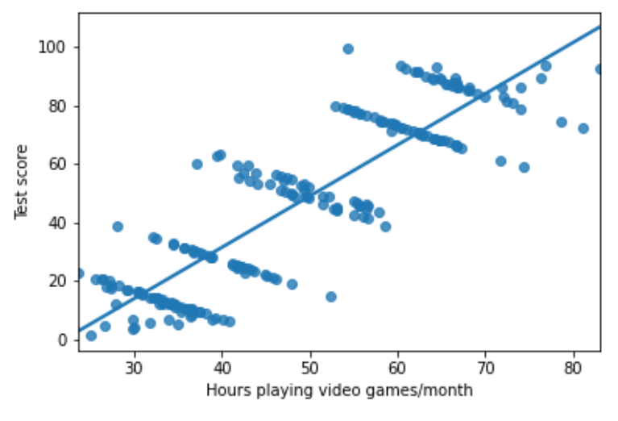
Brain Teaser 02
A study was conducted that shows that as the person will spend more hours playing video games then their test score will increase. Do you agree?
Notes:
Another study was conducted that shows that as the person will spend more hours playing video games then their test score will increase. Do you agree?

Slide 14
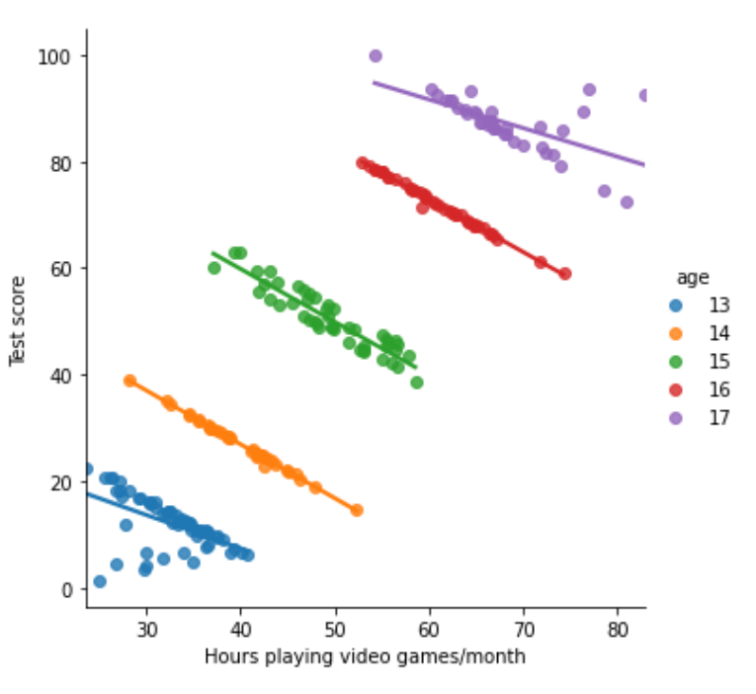
Brain Teaser 02
Simpson Paradox!
Notes:
Simpson Paradox: It occurs when the trend of a model on the whole dataset is very different from the trends shown by models on subsets of data.
We can see the downward trend between the X and Y variable when the variable “Age” was considered.
There are three kinds of lies: lies, damned lies, and statistics.— Mark Twain

Slide 15

THANK YOU
Training and Certification

Slide 16
What’s in it for you?
Forbes proclaim that Machine Learning Engineers, Data Scientists, and Big Data Engineers rank among the top emerging jobs on LinkedIn. 650% job growth since 2012 (source: LinkedIn).
A candidate with skills in SQL, ETL methodologies and data warehousing is 3 times more likely to get selected for a Data Scientist position.
According to PayScale, skills such as Data warehouse, ETL and Data Extraction combined, impacts your salary negotiations by more than 33%.
Data Engineer remains the top tech job enjoying a 101% increase in posting over past 12 months.
According to Glassdoor, the average salary is $120,931/year.
Training and Certification
Notes:
Why are we talking about data science, ML, and AI here? What’s in it for you?

Slide 17
What’s in it for us?
As little as one-quarter of 1% of the world knows how to code.
By 2024, low-code application development will be responsible for more than 65% of application development and project implementation activity. (source: Gartner)
Low code/no-code solutions have the potential to reduce the development and implementation time by 90%.
83% of businesses say AI is a strategic priority for their businesses today yet, there is not enough data science talent. (source: Forbes)
Global no-code market is predicted to generate a revenue of $187 billion by 2030, rising from $10 billion in 2019. (source: GlobeNewswire)
Training and Certification
Notes:
No code

